Slide 1
Over-fitting and Regularization
Chapter 4 textbook
Lectures 11 and 12 on amlbook.com

Slide 2
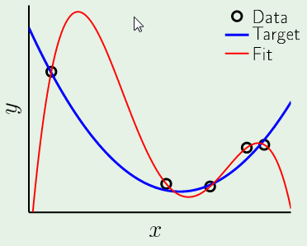
Over-fitting is easy to recognize in 1D
Parabolic target function
4th order hypothesis
5 data points -> E_{in} = 0

Slide 3
Shape of fit very sensitive to noise in data
Out-of-sample error will vary greatly from
one dataset to another.

Slide 4
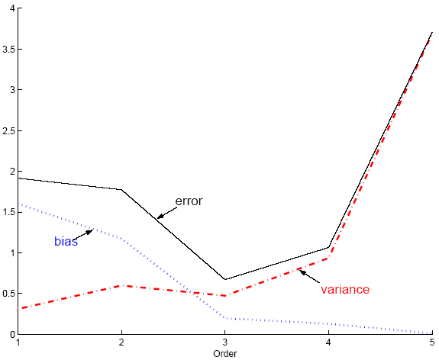
The origin of over-fitting can be analyzed in 1D:
Bias/variance dilemma. How does this apply to
case on previous slides?

Slide 5
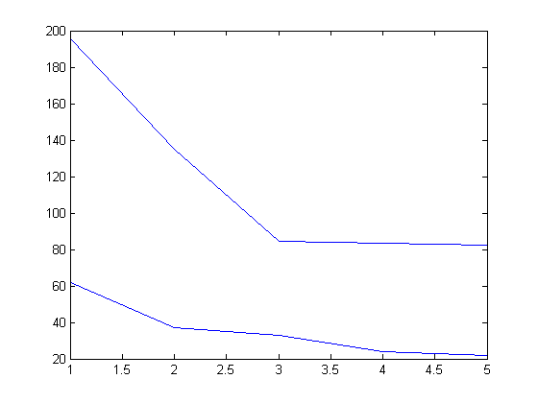
Over-fitting is easy to avoid in 1D:
Results from HW2
E_{val}
Sum of squared deviations
E_{in}
Degree of polynomial

Slide 6
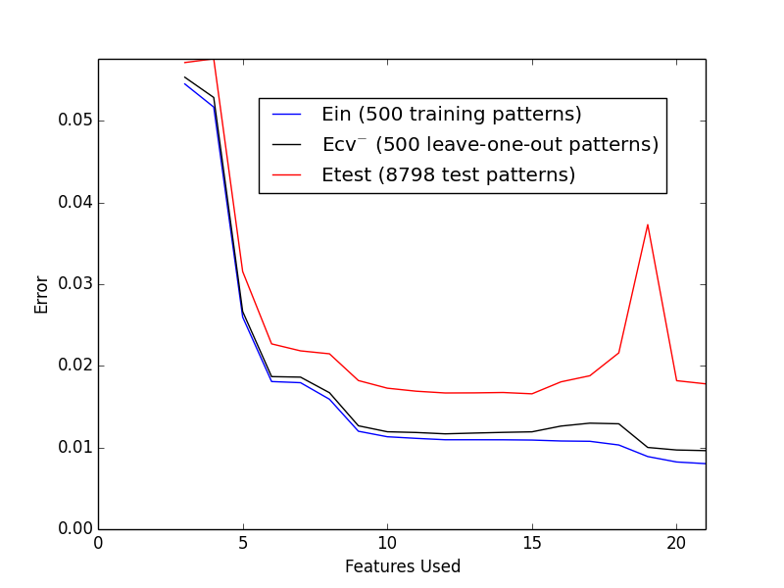
Using E_{val} to avoid over-fitting works in all dimensions but
computation grows rapidly with increasing number of attributes.
E_{in}
E_{cv-1}
E_{val}
EE
Digit recognition One vs Not one
d = 2 (intensity and symmetry)
Terms in Φ₅(x) added successively
500 pts in training set
Validation set needs to be large; 8798 this case

Slide 7
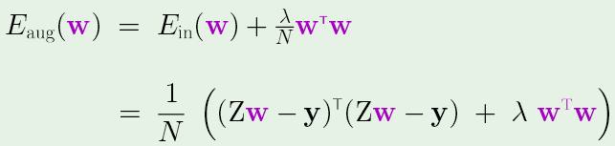
Extended linear models with “weight decay”: A simple form of
“regularization” to avoid overfitting.
As we add powers of attributes to a linear model,
(e.g. L+ x₁² + x₂² + x₁x₂ + x₁³ + x₂³ + x₁x₂² + x₁²x₂) |w| increases.
To diminish the importance of high powers in the optimum w,
add a “penalty” to the E_{in} proportional to |w|=w^{T}w.

Slide 8
Normal equations with weight decay are essentially unchanged
(Z^{T}Z + λI) w_{reg} =Z^{T}y

Slide 9
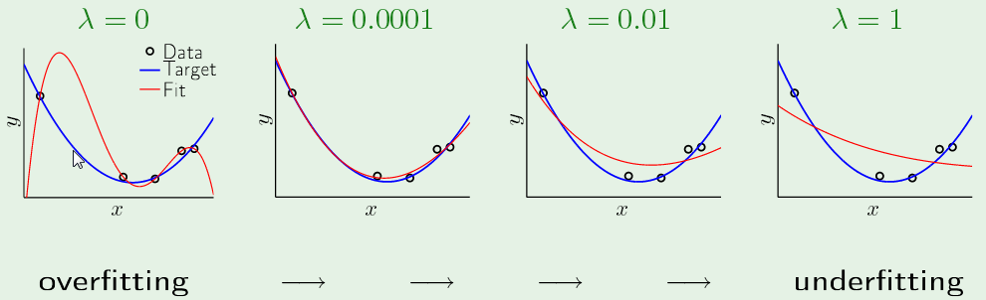
Use a validation set to find the best value λ
In this case λ = 0.0001 is large enough to suppress swings
but data still important in determining optimum weights.

Slide 10
Assignment 7 due 11-3-16
Generate an in silico dataset with 55 examples of y(x)=1+9x²+ N(0,1)
with randomly selected values of x between -1 and +1.
With training set of 5 samples, fit a 4th degree polynomial to the data with and without regularization by choosing λ = 0, 0.0001, 0.001, 0.01, 0.1, 1, and 10. Plot E_{in}.
Use the remaining 50 examples as a validation set. Plot E_{val}. Does the plot have an “elbow”? If not, what value of λ gives the smallest E_{val}?
Run your code 5 times. Does the best choice of λ change from run to run?

